Slide 1
MIL Theory + Newest Model
Divya Bhardwaj, Hannah Zhao, & Arush Iyer

Slide 2
High Level
Input data is grouped into labeled bags containing multiple instances
Labels are assigned at bag level
An entire bag is labeled as high-grade if it has 1 or more high-grade instances
Typical approaches:
Instance-level: classify each instance and aggregate to get bag-level classification
Embedding-level (preferred): map instances to low-level embeddings, aggregate the embeddings into a single, bag-level representation, and apply a classifier
Terminology
Instances: individual data points (in our case, patches)
Bags: collection of data points
Labels: tagline for the bag (high-grade or benign)
Why should we care?
Useful when labeling each instance is impractical/expensive
Especially useful for classifying medical image data
Notes:
Thus, embedding-level doesn't explicitly predict instance labels, focusing instead on a bag-level classifier, making it generally more flexible and powerful.
Steps: Make the bags, get the embeddings/features, train the classifier and perform attention pooling,

Slide 3
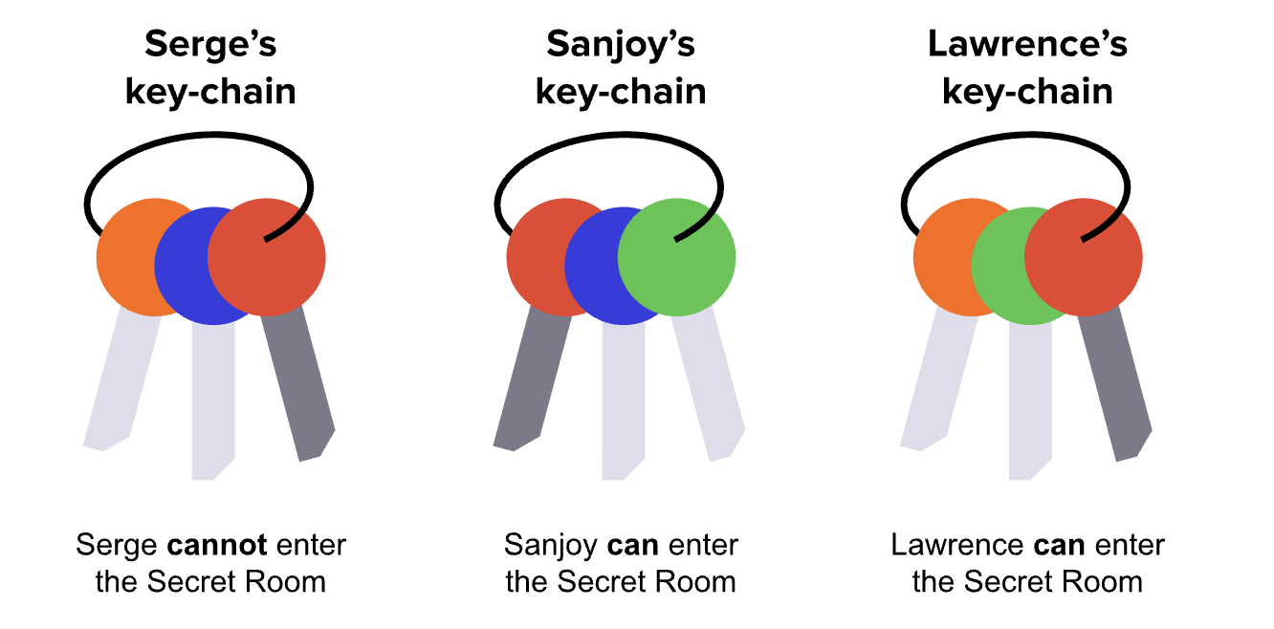
Key-chain analogy
Trying find the exact key that is common for all the “positive” keychains (green key)
Notes:
Doesn't’ matter if bags can’t be identified by a single instance (e.g., classifying desert, sea, and beach images). Might need several positive instance to distinguish a beach from the sea.

Slide 4
Mathematical Foundation (1)
Problem formulation
Bag of instances X = {x₁, x₂, …., x_{k}}, each x has a label y ∈ {0,1}
Bag label Y = max{y_{k}}
1 if at least one instance is positive, else 0
During training, you don’t know instance labels y_{k}
Use a permutation-invariant function:
Need to keep bag representation the same irrespective of order of instances within the bags
Punchline: can use average, max, or attention-based pooling
Attention-based pooling
Use a weighted average of the low-level embeddings created during feature extraction
Max pooling only picks the most extreme patch, ignoring useful info from other patches
Average pooling treats every patch equally which includes irrelevant or incomplete patches
Notes:
magine you have 10 patches: 8 completely normal patches 2 suspicious (possibly cancerous) patches Max pooling picks only one of those patches, ignoring the second potentially useful patch. Average pooling treats all 10 equally, diluting the importance of the 2 suspicious patches. Attention pooling automatically learns to assign high weights to the 2 suspicious patches and low weights to the other 8. You don't lose valuable information, and the irrelevant data doesn't pollute your result.

Slide 5
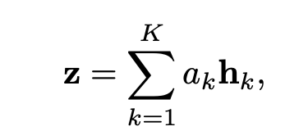
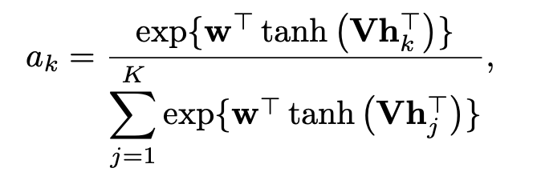
Mathematical Foundation (2)
Attention-based pooling
Given embeddings H = {h₁,...., h_{k}}, the bag embedding is the sum
where a_{k} is expressed as
Notes:
Attention scores a k ​ indicate how relevant each instance (patch) is for determining the bag-level label. They’re learned during training, allowing the model to identify crucial instances directly.

Slide 6
Mathematical Foundation (3)
Attention-based pooling
Each embedding transformed by a small neural network
V is a learned linear transformation, w is a learned weight
V ∈ R^{LxM}, w ∈ R^{Lx1}
L is size of the hidden layer and M is the size of the embedding (usually 512)
Tanh used so the model can capture nonlinear relationships
Rest is the softmax function

Slide 7
Explaining Attention (and Loss)
h_{k} – the patch embedding for k-th instance of bag (output from patch classifier – a 1D vector of shape [512])
V – weight matrix in attention MLP, learnable parameter – a matrix of shape [128, 512]
w – weight vector in attention MLP, learnable parameter – a 1D vector of shape [128]
Tanh – nonlinear activation function, to capture nonlinearity into the model
a_{k} – Attention score for patch k (scalar value)
exp() – softmax function so that all attention weights a_{k} ​∈(0,1)
Attention weights aren’t trained directly, but learned indirectly through minimizing overall classification loss
Use attention weights to aggregate into a single bag level prediction
Then cross-entropy loss is computed between prediction and true bag label
The loss is backpropagated through the classifier to calculate the gradients and update V, w, CNN, and the final classifier weights
Notes:
So h_{k} is a patch embedding that is a result of the Densenet feature extractor so that’s a 512-dimensional vector.
So in our current MIL, our raw attention score is computed through a 2 layer neural network, and there are 2 learnable parameters in this MLP.
V is a weight matrix of size 128 x 512 which basically projects the patch embedding (h_{k}) of size 512 into a 128-dimensional hidden layer, in other words we are applying a matrix multiplication to map a 512-dimensional vector into a new space with 128 dimensions (which are the dimensions as defined in the hidden layer of our neural network).
Think of the 512-dim patch embedding as a detailed description of a patch. The 128-dim projection is a compressed version that captures the features most useful for computing attention.
Then after we apply that matrix multiplication (which is between the weight matrix and the patch embedding) we pass it through the Tanh activation function which introduces nonlinearity, because without it our attention network would just be a linear transformation.
Next, the second linear layer is applied using w, which is a weight vector of shape 128, and this is a learnable weight vector that maps the hidden layer output to a scalar score.
This is done by taking the dot product between the vector of 128 dimensions outputted by the tanh function and w.
The softmax function is applied across all the patches in the bag in order to get all weights across the bag to sum to 1
One more important thing to understand is that attention weights aren’t trained directly but learned indirectly through minimizing the overall classification loss. So after the prediction for whether or not the bag is high grade CMIL is made, the cross entropy loss is calculated and then backpropagated through the entire model.
So, in other words, the gradient of the loss to each of the trainable parameters such as V, w, the CNN weights are calculated and then with our optimizer which I believe is Adam, uses these gradients to update the parameters to reduce the loss.

Slide 8
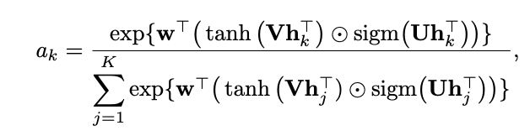
Mathematical Foundation (4)
Gated attention mechanism
Motivation: tanh is linear over [-1,1]
Gated attention adds the sigmoid function to introduce an additional learnable nonlinearity
U ∈ R^{LxM} is an additional learned parameter, ☉ is element-wise multiplication
In theory, adds more flexibility to MIL
Notes:
https://arxiv.org/pdf/1802.04712
^ source

Slide 9
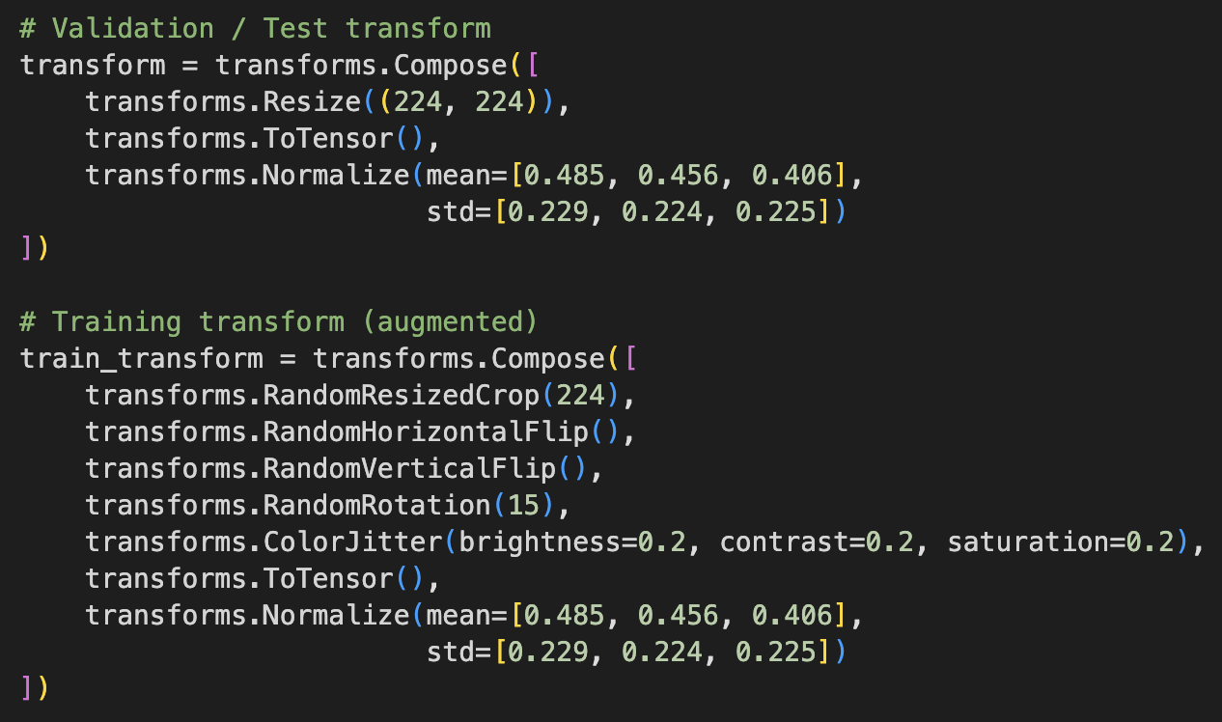
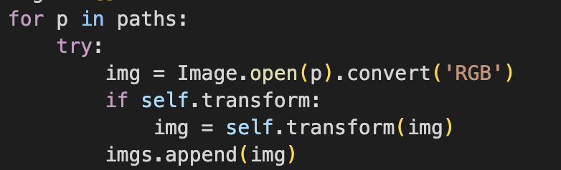
Initial Patch Size
The images are resized to be 224x224
There are three channels (RGB)
At this point, the patches have the shape (C, H, W) of (3, 224, 224)

Slide 10
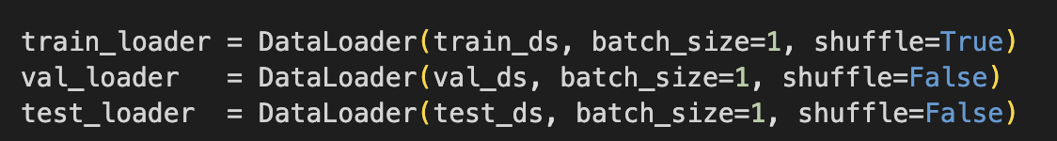
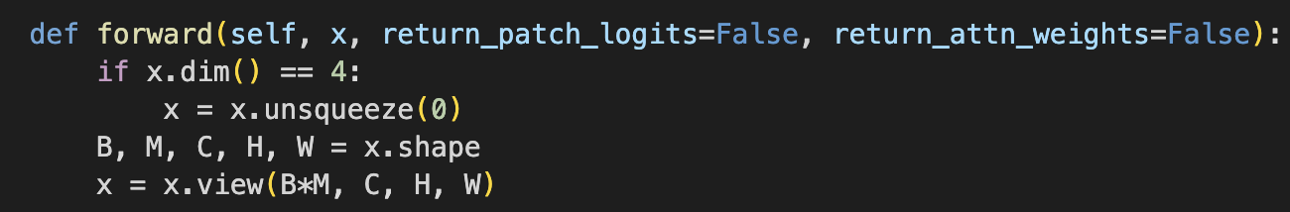
Input to MIL Model
The data loader uses a batch size of 1
Meaning when data is passed into the model, it is one bag/slice at a time
The code then checks to ensure the shape is (B, M, C, H, W), where B is the batch (1, as described above) M is the number of patches (variable by slice), and C, H, and W, are (3, 224, 224), as described on the last slide, for a shape of (1, M, 3, 224, 224)
This input is then flattened to (B*M, C, H, W) to run all patches through the feature extractor
Since B=1, noted above, the input is then (M, 3, 224, 224)

Slide 11
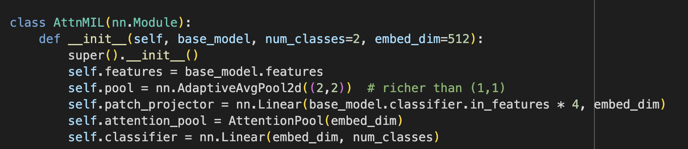
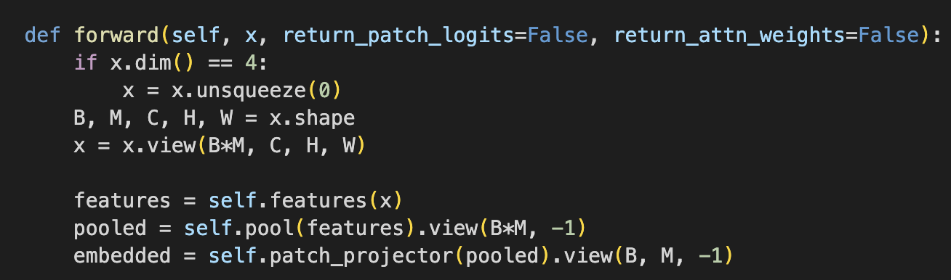
Feature Extraction, Pooling, Embedding
The shape after feature extraction is then (B*M, F, H', W'), where F is the number of features from the DenseNet layers and H' and W' are the reduced dimensions
for DenseNet, F is 1024 and H’, W’ varies but can often be 7x7
putting it together, shape is (1*M, 1024, H’, W’)
Then, Adaptive Pooling reduces the spatial dimensions (H’ and W’) to 2x2
at this point, the shape is (M, 1024, 2, 2)
Then, it flattens each patch to (M, 1024*2*2) for a shape of (M, 4096)
The features are then passed through a linear layer (patch_projector) where they are projected to the lower-dimensional embedding set forth by embed_dim = 512
So the dimensions are (M, 512)

Slide 12
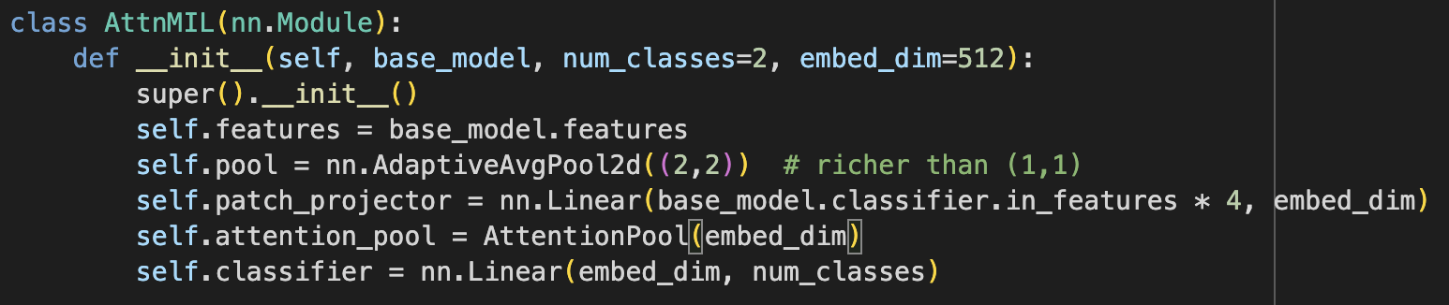
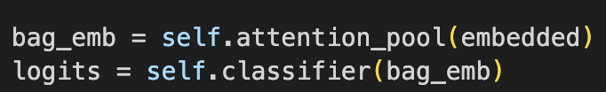
Attention Pooling and Final Classification
After attention pooling, we get an output shape of (B, D), where B is the batch number and D is the embedding dimension, which is 512.
Therefore, the output is (1, 512)
Single vector representing entire bag
Then, the bag-level embedding is passed through the classifier
The output of the classifier is the logits for each class (here, benign and high grade)
Therefore, the shape is (1, 2), giving the final logits for classification
Then, the sigmoid function will be applied on these logits to compute its probability of being high-grade (scalar value). Final shape is (1, 1).

Slide 13
Summary of Shape Changes
Initial Patch image input loaded and resized (3, 224, 224) – (C, H, W)
Batch input to MIL model (M, 3, 224, 224) – (B, M, C, H, W)
Input to DenseNet (M, 3, 224, 224)
Output from DenseNet.features (M, 1024, H, W)
AdaptiveAvgPool2d((2,2)) (M, 1024, 2, 2)
Flattening Densenet Output (M, 1024, 2, 2) → (M, 4096)
Patch Projector (M, 4096) → (M, 512)
Attention Pooling
(M, 512) is passed through the following MLP:
Linear layer → Tanh → Linear layer
Outputs a single vector representative of the entire bag (1, 512)
Final Classifier
Input is Bag-level embedding (1, 512)
Passed through a linear layer (1, 2), which are the logits for each case, and sigmoid function
Output is scalar value y^∈[0,1] predicting the probability of high grade CMIL
Notes:
We start with the initial patch image which has 3 RGB channels of 224 pixels height and width. When we applied our transformations in PyTorch, the image is converted to a tensor of shape (3, 224, 224). A tensor is just the standard format for CNN inputs in PyTorch.
This is then passed into the MIL model. When the patches are grouped into a bag, the data shape becomes (B, M, C, H, W) where B is the batch size, M is the number of patches in that bag. The rest is just the image shape (3, 224, 224)
These patches are then passed through the DenseNet feature extractor, one at a time. And the DenseNet121 architecture outputs 1024 feature channels for each patch, so after going through convolutional layers, the output shape is (M,1024,H,W) Here, H and W are spatial dimensions that depend on the DenseNet121 architecture, which in our case is 7, so it’s 7 by 7. And this refers to the matrix of values per feature channel, so these are learned features that summarize the information from different parts of the image.
We then apply an adaptive average pooling layer to reduce the spatial size of each feature map to 2×2. So the shape becomes (M,1024,2,2). This gives us 4 spatial values per channel instead of 49.
Next, we flatten the densenet output so each patch becomes a 4096-dimensional vector. (number of feature channels * number of spatial features per channel)
This vector is passed through a projection layer, which reduces the dimensionality from 4096 to 512. This is done for memory and computational efficiency. This linear projection layer is a learned parameter that changes depending on cross entropy loss.
Now, for attention, for each patch embedding of the M patches, it is passed through a neural network that outputs a single vector representative of the entire bag of size (1, 512).
Finally, the bag level embedding is passed through the final classifier, where it goes through a final linear layer and a sigmoid function that produces an output between 0 and 1 which is the final prediction.

Slide 14
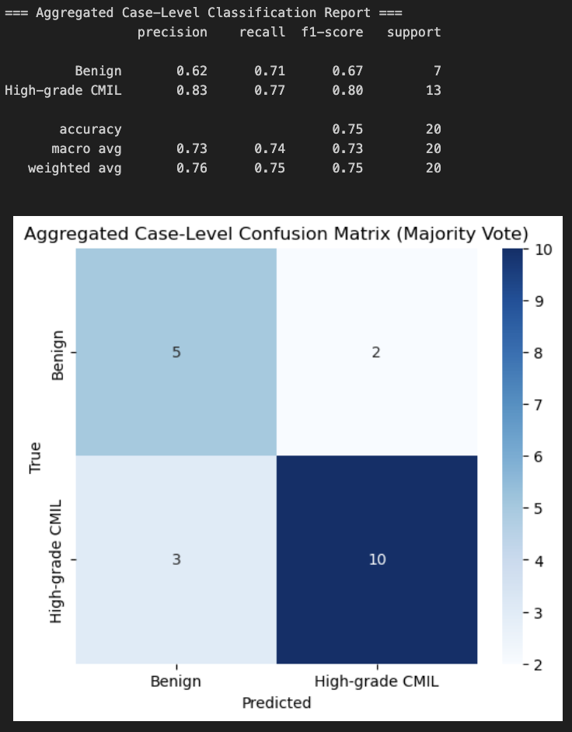
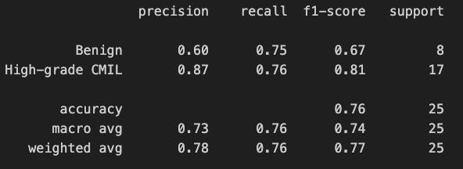
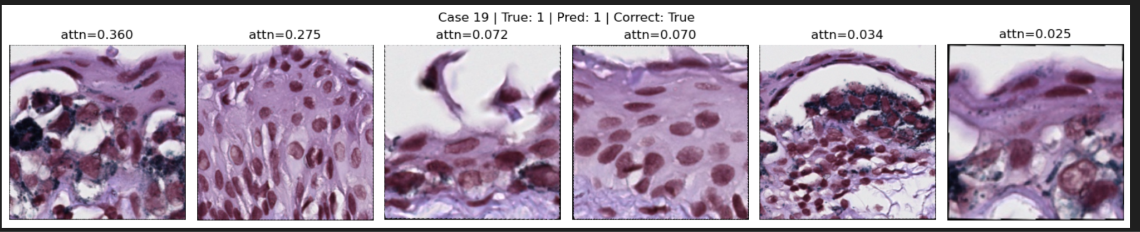
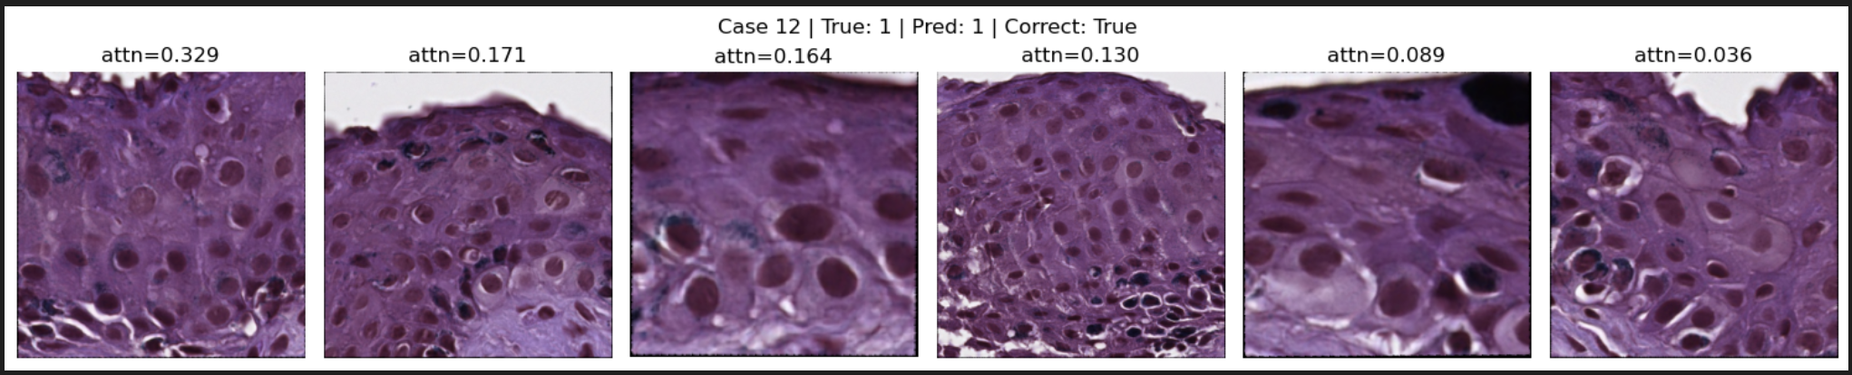
MIL Grouping by Slice Results (h&e stains only)
Notes:
Significant improvements!

Slide 15
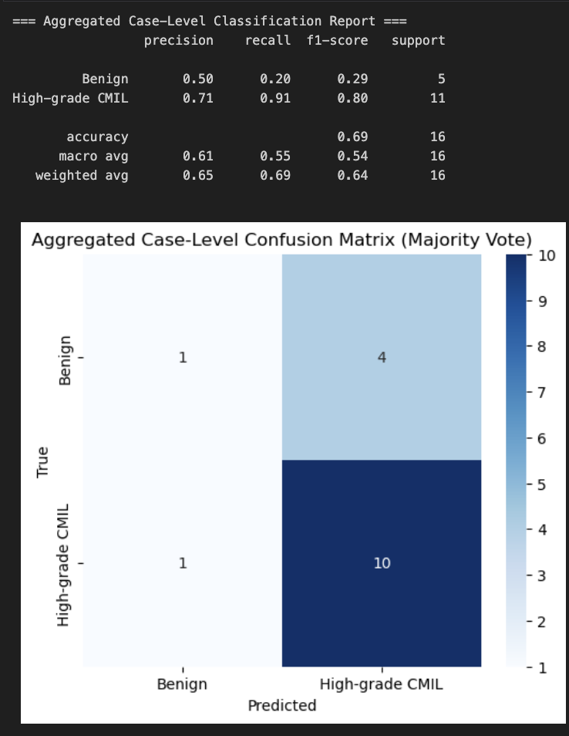
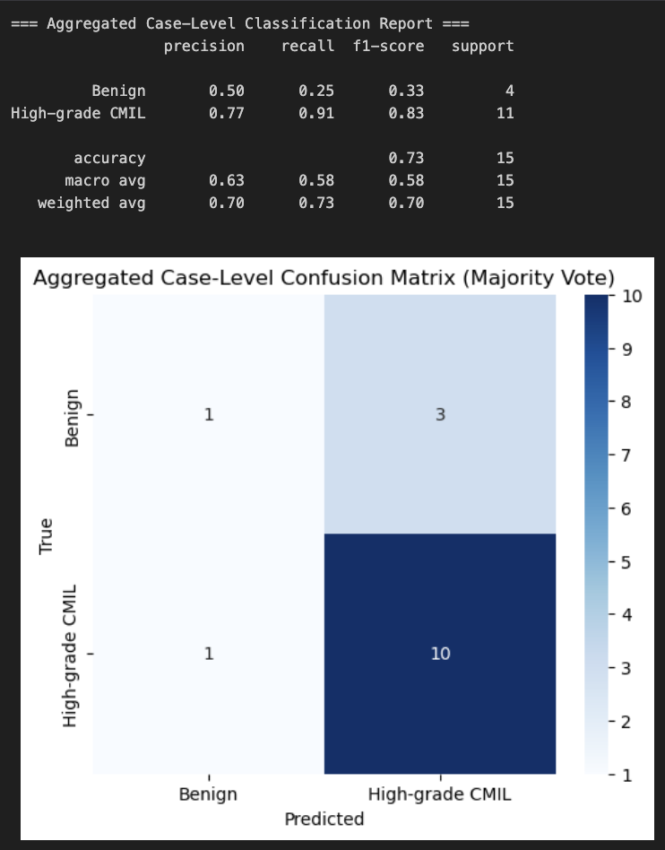
Melan Sox10
Notes:
Also tried to run on the other stains. So I was very surprised at how much worse they were performing, but realized that it was because my pretrained densenet classifier was trained on h&e stains only, so it makes sense why my models weren’t learning for these stains, since the patch classifier is probably not extracting the right features.
However, I think we could expect drastic improvements once a good patch classifier is used for each of these stains, just by seeing that the h&e stains saw such drastic improvement.
Each of these models took overnight to run, which was why by the time I realized that I made this mistake, which was yesterday, I didn’t have the time to try anymore models. But I think that this is worth pursuing.

Slide 16
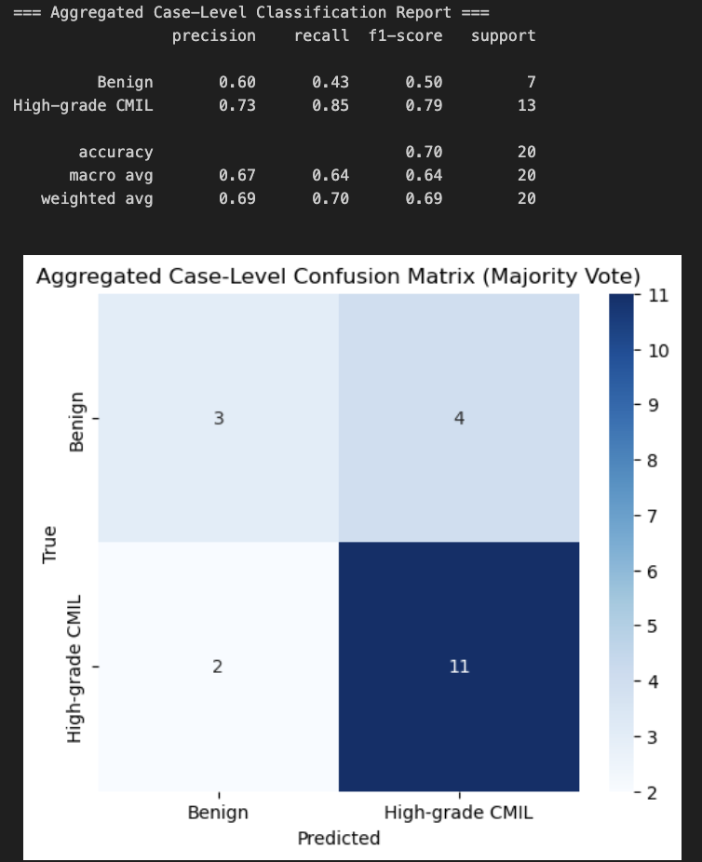
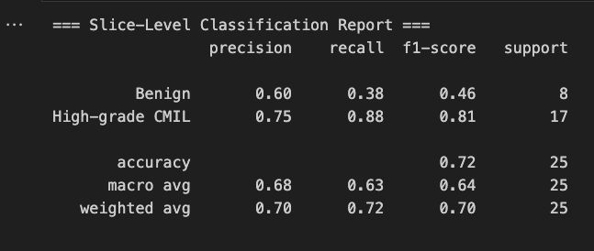
MIL with Gated Attention
Notes:
I also implemented MIL with Gated Attention, but it didn’t seem to perform as well as the attention pooling before.
Difference is introduces another sigmoid activation layer, more complex and more learnable parameters.

